Slide 1
Office 365 development

Slide 2
Deep dive into SharePoint-hosted apps

Slide 3
Agenda
Introduction
Programming in JavaScript
App parts
UI custom actions

Slide 4
Developer vision
USERS
DATA
HTML

Slide 5
Introduction

Slide 6
Architecture
SharePoint 2013
App web
Host web
Web services
Notes:
App Web is a sub web under the host web
App web is a separate domain
App web is created during app installation process
App web contains pages and other declarative SharePoint artifacts
App web is limited to JavaScript
App web can access host web as long as it has appropriate permissions
May call to other cross-domain resources using appropriate techniques such as cross-origin resource sharing (CORS) or a web proxy

Slide 7
Introduction
App web is isolated in its own domain
Enforces “same origin” policy for the app
Allows for authentication and authorization when calls are made to the host web
Each app has it’s own unique URL
Tenancy: your organization’s tenancy
App Unique Identifier: unique generated identifier for the app instance
Hosting Domain: defined for each farm
App Name: contained in the app manifest
https://[tenancy]-[appuid].[hostingdomain]/[appname]
The app web
Notes:
Each app web is isolated in a unique domain

Slide 8
Introduction
Specified in app manifest
~appWebUrl/Pages/Default.aspx? {StandardTokens}
Utilizes tokens for dynamic replacement of parameters
~appWebUrl token representing the URL for the app web of this app instance
{StandardTokens} passes key query string parameters to the app on launch
App Start Page
Parameter | Description
SPHostUrl | The URL of the host web
SPAppWebUrl | The URL of the app web
SPLanguage | The language/culture of the host web
SPClientTag | The client cache control number for the current website
SPProductNumber | The full build version number of the SharePoint farm
Notes:
{StandardTokens} combines five other tokens. It initially resolves to SPHostUrl={HostUrl}&SPAppWebUrl={AppWebUrl}&SPLanguage={Language}&SPClientTag={ClientTag}&SPProductNumber={ProductNumber}. Then each of these tokens resolves. If there is no app web, the portion &SPAppWebUrl={AppWebUrl} is not present.

Slide 9
Introduction
Utilizes “internal” authentication
App permissions are the lesser of user and app permissions to the given resource
App permissions
Notes:
No Oauth tokens required

Slide 10
Introduction
Full page
Required for all apps
Experienced when an app is launched from the contents page
App part
Optional
Allows an app to be hosted in an IFrame on the host web
UI custom action
Optional
Allows an app to be launched from the ribbon or Edit Control Block (ECB)
App shapes
Notes:
These are the different experiences
We’ll cover these in detail as we go along

Slide 11
Introduction
Pages
ASPX
HTML
Authorization
Internal
Programmability
JavaScript REST or CSOM
JavaScript cross-domain library
Web proxy
Creating SharePoint-hosted apps
Notes:
SharePoint-Hosted apps can be built on ASPX or HTML pages
The authorization is always done with “Internal” auth, meaning no OAuth tokens
Programmability is always JavaScript
You can use CSOM, REST, cross-domain library, or web proxy in your solution

Slide 12
Demo
Creating a SharePoint-hosted app

Slide 13
Programming in JavaScript

Slide 14
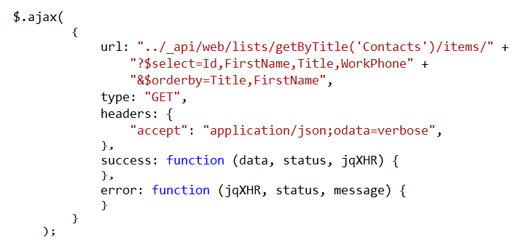
Using the REST API
Programming in JavaScript
Notes:
This is a READ sample. The other CRUD operations follow.

Slide 15
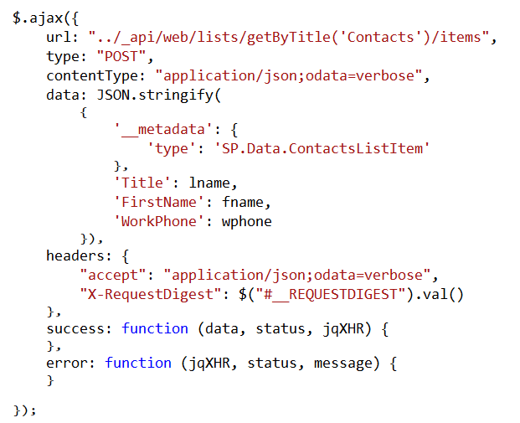
Create list items
Programming in JavaScript

Slide 16
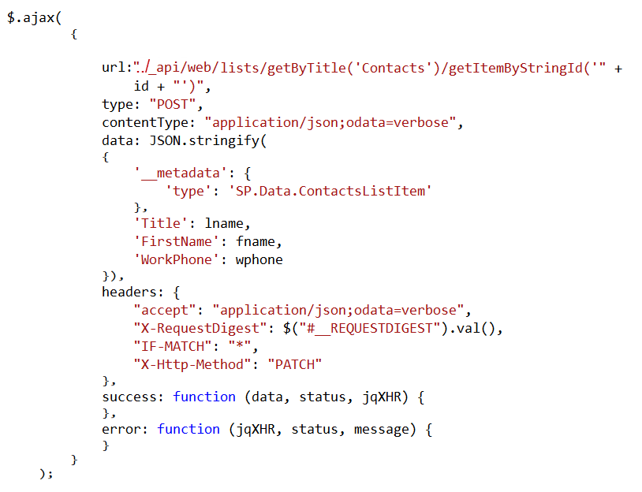
Update list items
Programming in JavaScript

Slide 17
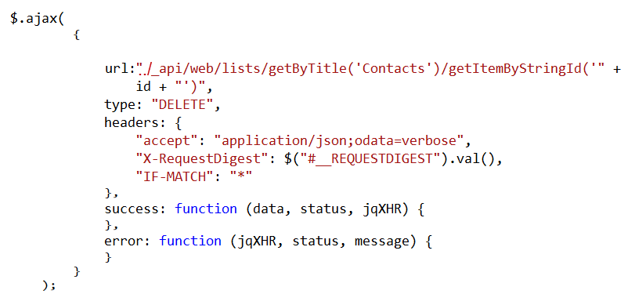
Delete list items
Programming in JavaScript

Slide 18
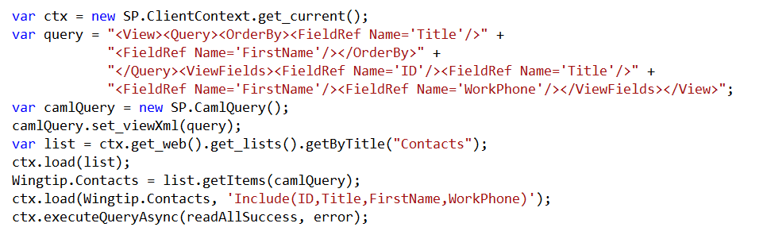
Using the CSOM API
Programming in JavaScript
Notes:
This is a READ sample. The other CRUD operations follow.

Slide 19
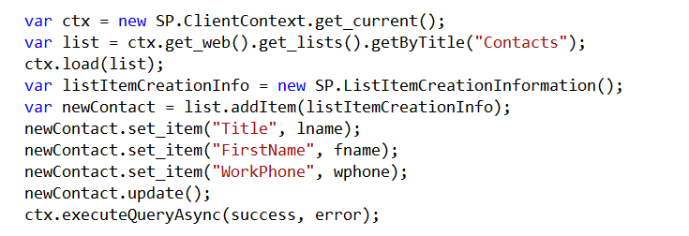
Create list items
Programming in JavaScript

Slide 20
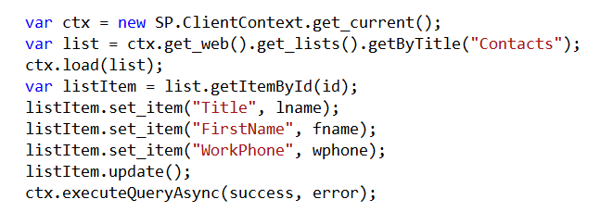
Update list items
Programming in JavaScript

Slide 21
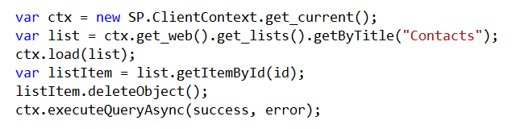
Delete list items
Programming in JavaScript

Slide 22
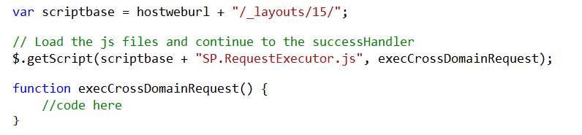
Cross-domain library
Programming in JavaScript
Same-domain policy prevents JavaScript from making direct calls to the host web
SP.RequestExecutor.js located in layouts directory
Option 1: reference directly
Option 2: load dynamically
Notes:
Makes it possible to call the host web from JavaScript in the app web

Slide 23
Cross-domain library architecture
Programming in JavaScript
SharePoint
Host web
App web
IFRAME
AppWebProxy.aspx
AppWebProxy.aspx
SP.RequestExecutor.js
Notes:
The app web loads the SPRequestExecutor.js library
The app web creates a new SP.RequestExecutor object, initializing it with the URL of the app web
This causes a hidden IFRAME to be created, which loads APPWebProxy.aspx from the LAYOUTS directory
The SP.RequestExecutor object uses the HTML5 postmessage command to send requests from the remote web
The request is executed by the AppWebProxy.aspx page
The response is returned

Slide 24
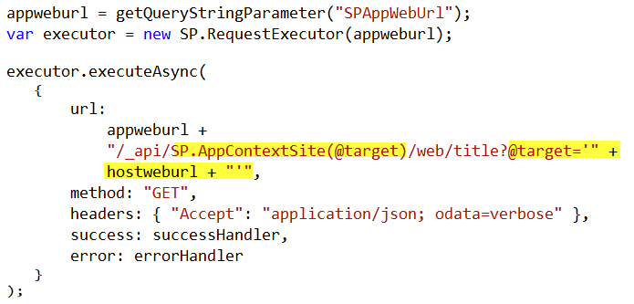
Cross-domain REST calls
Programming in JavaScript
Notes:
When calling the host web, you must switch the context

Slide 25
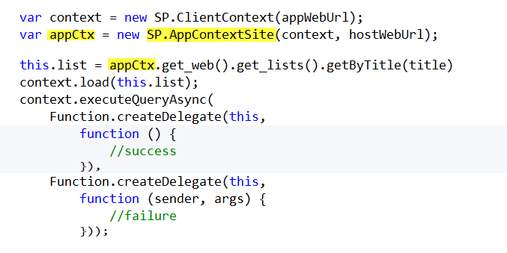
Cross-domain CSOM calls
Programming in JavaScript
Notes:
When calling the host web, you must switch the context

Slide 26
Demo
CRUD operations against the host web

Slide 27
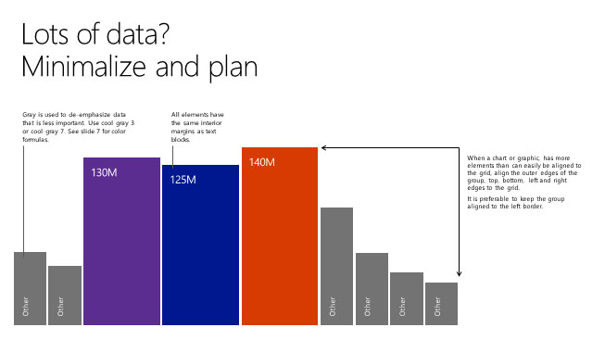
App parts

Slide 28
App parts
Allow functionality to be added to pages in the host web in a manner similar to web parts
App part is rendered through an IFRAME on the host web
App part is defined using the client web part
Supported in both SharePoint-hosted and provider-hosted apps
App parts

Slide 29
App parts
References the page that should display in the Iframe
Supports the creation of properties that appear in the property pane when the app part is added to a page in the host web
Client web part

Slide 30
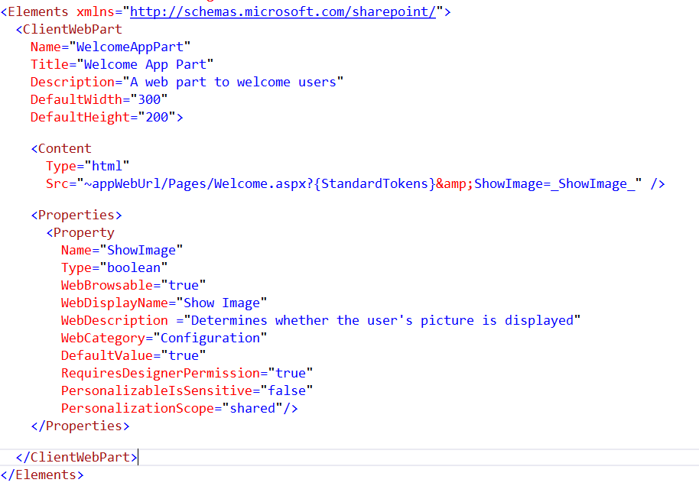
Client web part CAML
App parts

Slide 31
Demo
App parts

Slide 32
UI custom actions

Slide 33
UI custom actions
Can extend the ribbon or Edit Control Block (ECB)
Launches a target page in your app
Supports the addition of tokens to pass information to the app
UI custom actions

Slide 34
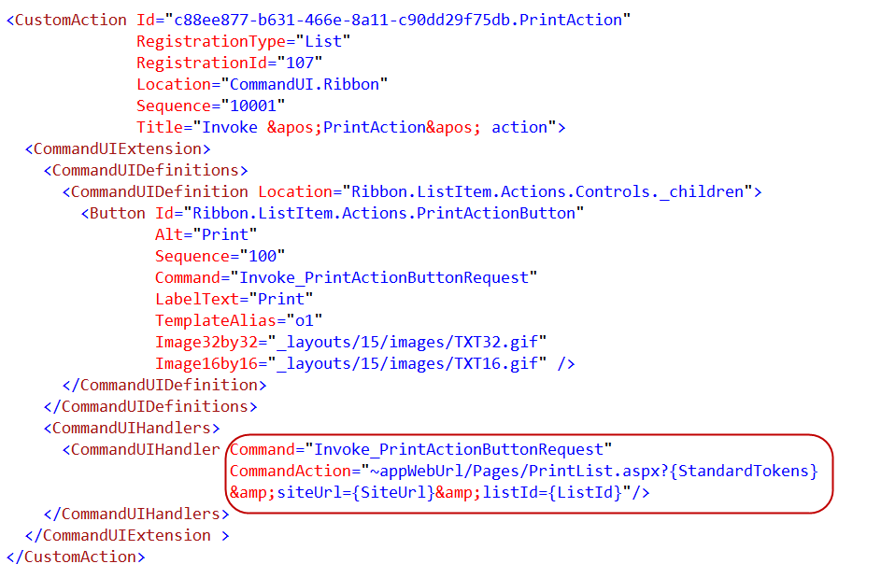
Custom action CAML
UI custom actions

Slide 35
Demo
UI custom actions

Slide 36
Summary
Introduction
Programming in JavaScript
App parts
UI custom actions

Slide 37
Developer Program Launch
1 YEAR FREE
Email Newsletters
Free Developer Subscription
Free Training
Free Tools
Webinars
http://dev.office.com/devprogram

Slide 38


Engage
Office 365 Network
https://www.yammer.com/itpronetwork
Twitter
S
S
t
t
a
a
r
r
t
t
@OfficeDev
Stack overflow
[ms-office]
Channel 9 Dev Show
http://aka.ms/O365DevShow
Podcasts http://dev.office.com/podcasts
Snack Demos
http://aka.ms/o365DevSnackDemos
UserVoice
http://officespdev.uservoice.com/

